Slide 1


Emotional Intelligence & Customer Excellence
1

Slide 2
Course Overview:
By the end of this session, participants will learn to:
Identify components of emotional intelligence.
Explore various techniques for managing emotions.
Handle different types of customers.
Create customer delight.
Key topics covered:
Module 1 – Self-Awareness
Module 2 – Self-Regulation
Module 3 – Self-Motivation
Module 4 - Empathy
Module 5 – Social Skills
Notes:
Notes to trainers:
Welcome your group again and walk them through the new topic’s modules and objectives

Slide 3
Do you usually recognize the emotions you are feeling?
6

Slide 4
What is Emotional Intelligence (EQ)?
Emotional intelligence is the ability to recognize your emotions, understand what they're telling you, and realize how your emotions affect people around you. It also involves your perception of others: when you understand how they feel, this allows you to manage relationships more effectively.
7

Slide 5

Why Emotional Intelligence?
IQ
EQ
Success
Notes:
Notes to trainers:
Research has shown that EQ is a better predictor of success than intelligence quotient (IQ) or technical skills (Feist & Barron, 1996). Individuals with high EQ focus on the positive, listen before making decisions, admit mistakes, show empathy, and deal appropriately with negative emotions
Highlight the importance of having EQ in business

Slide 6
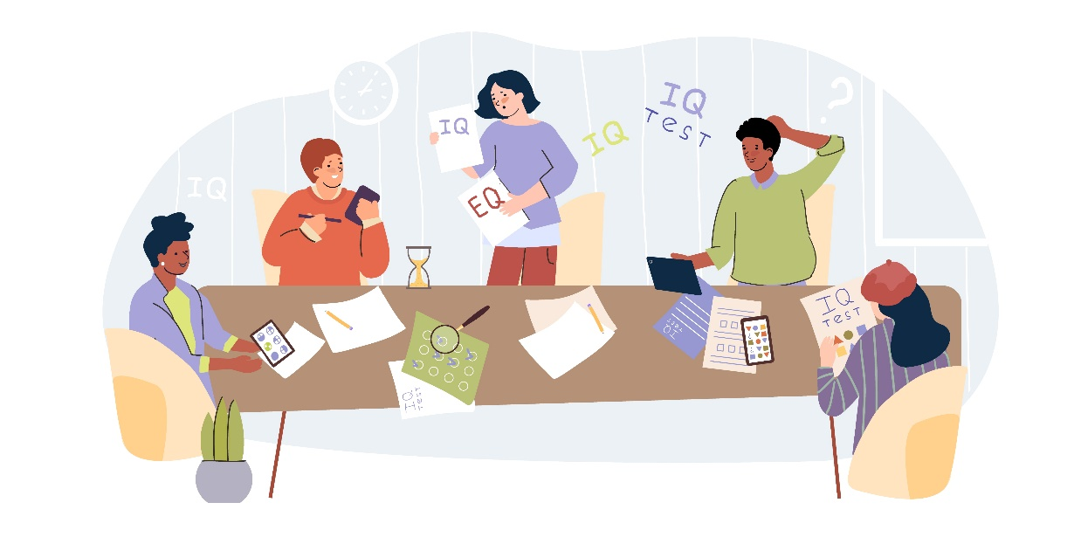
The Difference Between IQ and EQ
Notes:
Ask students to share their ideas about the difference between IQ & EQ

Slide 7
EQ Vs. IQ
EQ | IQ
Emotional quotient | Intelligence quotient
Measure of emotional competency | Measure of cognitive abilities
Involves identifying, controlling, and using emotions | Involves processing, knowledge, memory, and reasoning
Affects motivation, empathy, relationships, self-awareness, and self-control | Affects academics, expertise, critical thinking, and logic

Slide 8
Why are Emotional Intelligence Skills Important?
9
Notes:
Ask students to share their ideas

Slide 9
Importance of Emotional Intelligence
Leadership
Communication
Self-knowledge
Emotional intelligence allows you to be a more effective leader.
Understanding how others are feeling allows you to communicate with them better.
Being more aware of what you are feeling allows you to understand yourself more deeply.
Self-control
Stress Management
Awareness of your emotions also allows you to develop your self-control abilities.
Managing your emotions effectively allows you to exert greater control in situations marked by stress or conflict.
Notes:
Possessing strong emotional intelligence skills can have several positive effects on a person's life. People with such skills can keep their cool, for example. They can handle even the most awkward social situations with grace and make others feel at ease. Some of the benefits of having good emotional intelligence skills include improvements in each of these areas:
Leadership: Emotional intelligence allows you to be a more effective leader.
Communication: Understanding how others are feeling allows you to communicate with them better.
Self-knowledge: Being more aware of what you are feeling allows you to understand yourself more deeply.
Self-control: Awareness of your emotions also allows you to develop your self-control abilities.
Stress management: Managing your emotions effectively allows you to exert greater control in situations marked by stress or conflict.
Emotional intelligence skills also allows you to feel greater empathy for the people around you. This skill plays an important role in developing and maintaining interpersonal relationships. Creating strong connections with others enables you to foster a strong social support network, which plays a pivotal role in both physical and mental health.

Slide 10
How can we be Emotionally Intelligent?
9

Slide 11
Components of Emotional Intelligence
Emotional Intelligence
10

Slide 12

11

Slide 13
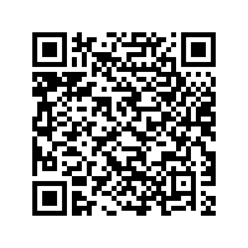
12
Notes:
https://www.educaplay.com/learning-resources/19097380-emotional_intelligence.html

Slide 14
Components of Emotional Intelligence
Emotional Intelligence
L
13

Slide 15
Components of Emotional Intelligence
Self
Awareness
14

Slide 16
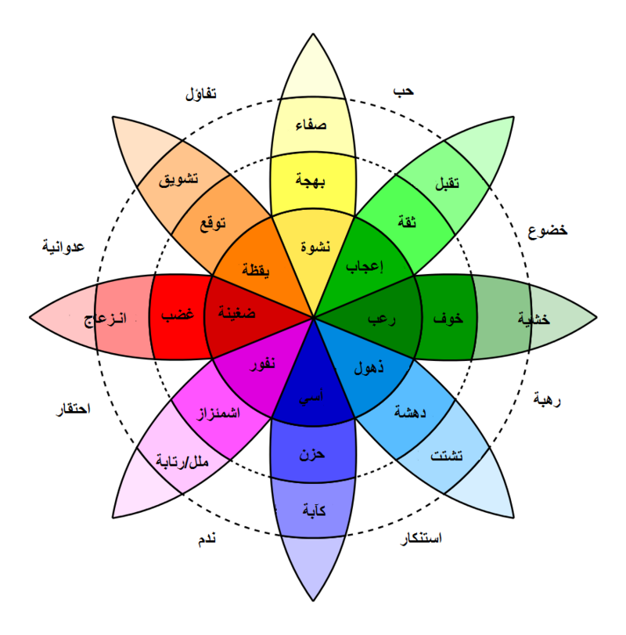
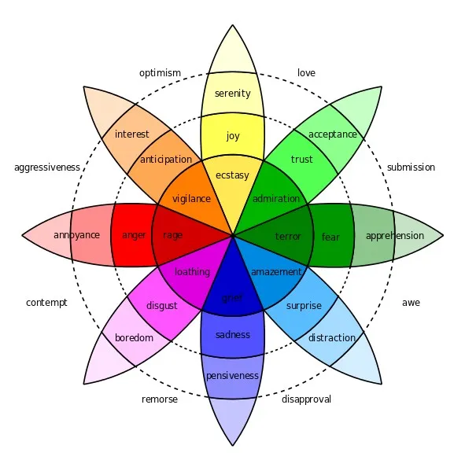
What are Emotions? How Do You Feel?
15
Notes:
https://www.6seconds.org/2022/03/13/plutchik-wheel-emotions/
Prepare the wheel of emotions and explain some of them as examples
Primary: The eight sectors are designed to indicate that there are eight primary emotions: anger, anticipation, joy, trust, fear, surprise, sadness and disgust.
Opposites: Each primary emotion has a polar opposite. These are based on the physiological reaction each emotion creates in animals (including humans… Plutchik studied animals!):
Joy is the opposite of sadness. Physiology: Connect vs withdraw
Fear is the opposite of anger. Physiology: Get small and hide vs get big and loud
Anticipation is the opposite of surprise. Physiology: Examine closely vs jump back
Disgust is the opposite of trust. Physiology: Reject vs embrace

Slide 17
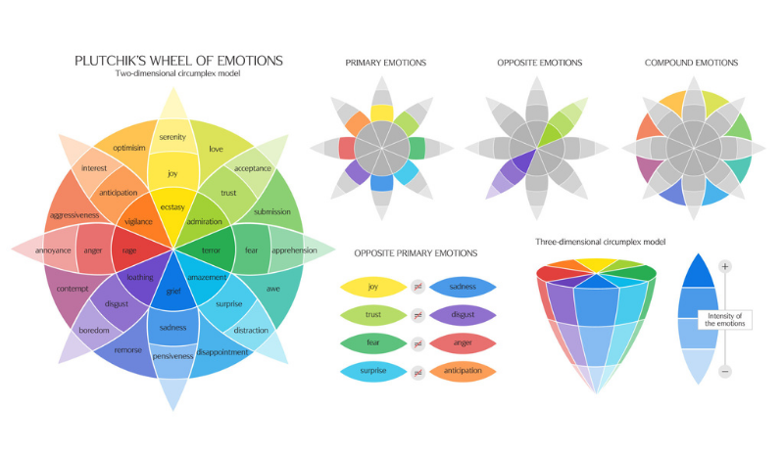

Slide 18
Components of Emotional Intelligence
Emotional Intelligence
Self
Awareness
16

Slide 19
Components of Emotional Intelligence
Self Regulation
17

Slide 20

What is Self-Regulation?
Self-regulation is the ability to control one's behavior, emotions, and thoughts in the pursuit of long-term goals. In other words, It is the ability to think before acting.
18

Slide 21
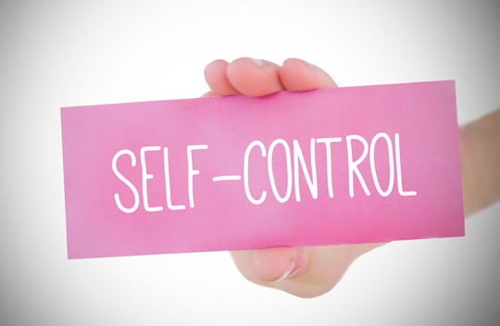
Individual Activity: Mention a challenging situation where you were able to show self regulation & mention how you did that.
Notes:
Notes to trainers: (5 minutes)
Allow a sample of participants to share a challenging situation and clarify how they showed self-control while dealing with this specific situation.

Slide 22
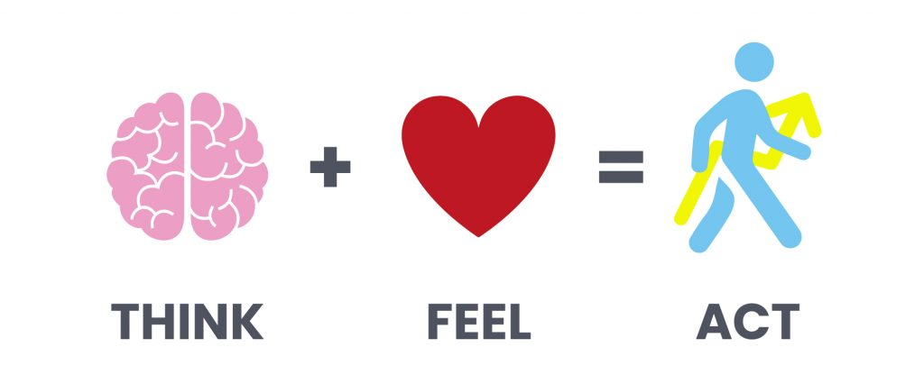
Remember
Notes:
Ask: What is the relation between your feelings and your actions?
Our actions are based on our thoughts and feelings
Ask some students to share how they act when having certain feelings
For example if you feel angry before an important customer meeting

Slide 23


Slide 24

Emotional VS Behavioral Self-Regulation
Behaviors
Emotional Self-Regulation
It focuses on managing our emotions. This involves recognizing emotions as they arise, understanding what triggers them, and developing healthy ways to cope with them.
Behavioral Self-Regulation
It is all about controlling our actions and directing our behavior in a way that aligns with our goals and the situation.
Emotions
19

Slide 25
Self Regulation Process
1. Be aware of the emotion
2. Identify thoughts/beliefs
3. Check consequences of actions
5. Act differently
4. Change thoughts

Slide 26
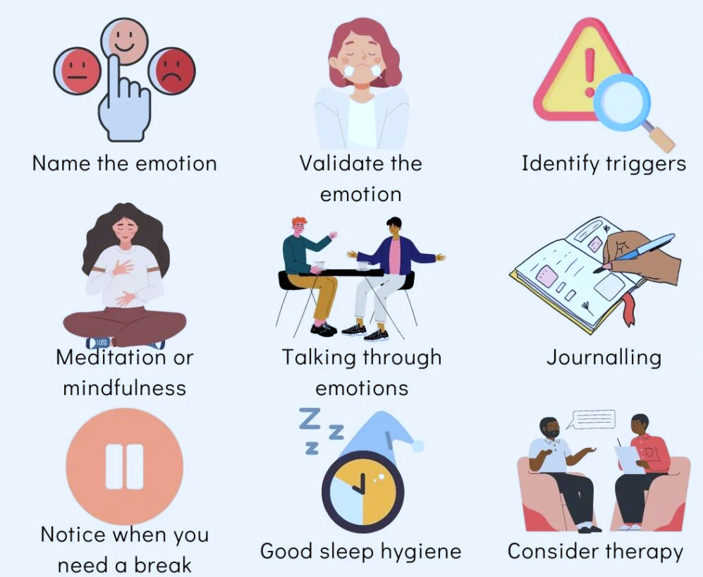
Emotion Regulation Strategies
Notes:
These are some more techniques for self regulation
Ask some students to share which of these techniques they use and what works for them

Slide 27
Let’s Apply Business Situations – What to do?
You are in a meeting with a client, and he provokes you by using some negative words.
Someone writes negative feedback on your performance and posts it on social media.
You feel disappointed because you applied for 3 deals or jobs and did not get them.
Notes:
Notes to trainers: (10 minutes)
Step 1:
Read the situations and ask some participants to share their answers.
Step 2:
You can role play with some students to allow them to apply the actions they mentioned

Slide 28
Components of Emotional Intelligence
Emotional Intelligence
Self
Awareness
Self
Regulation
21

Slide 29
Components of Emotional Intelligence
Self
Motivation
22

Slide 30

Motivation VS Inspiration
Motivation
Motivation is what pushes us to achieve our goals, feel more fulfilled, and improve our overall quality of life. It is your why that keeps you moving.
Inspiration
Inspiration is the spark that ignites a new idea or goal. However, the thing about that spark is it doesn’t last.
23

Slide 31

Individual Activity: Write 3 things you do to motivate yourself.
Notes:
Ask students to share their ideas on the chat
Find common things
Optional: You can use mentimeter

Slide 32

Let’s Take a Quick Quiz
Notes:
https://docs.google.com/forms/d/e/1FAIpQLSc1YWqc7Wpclogh_uGeWfrpE6EUqYOjxob_0LSsIsaiYgviGA/viewform?usp=sharing
Allocate 5 minutes for the quiz
Send them quiz link via chat

Slide 33

BREAK TIME (15 Mins)

Slide 34
24

Slide 35
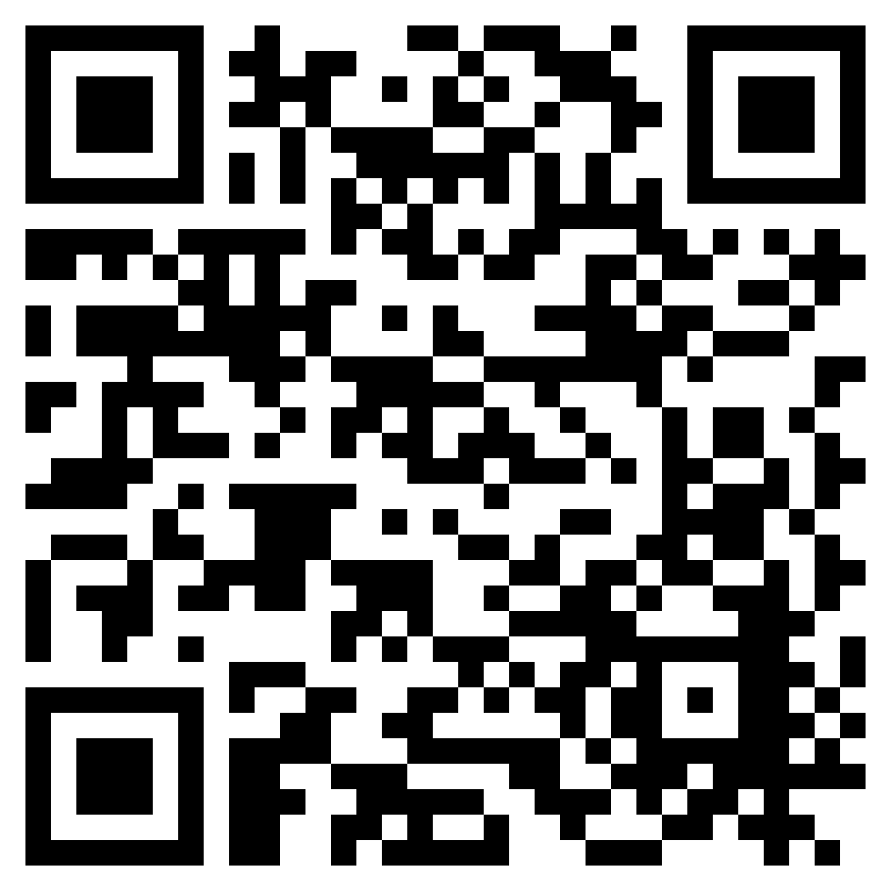
25
Notes:
https://www.jigsawplanet.com/?rc=play&pid=1fcef9196118

Slide 36
Components of Emotional Intelligence
Emotional Intelligence
Self
Awareness
Self
Regulation
Self
Motivation
26

Slide 37
Components of Emotional Intelligence
Empathy
27

Slide 38
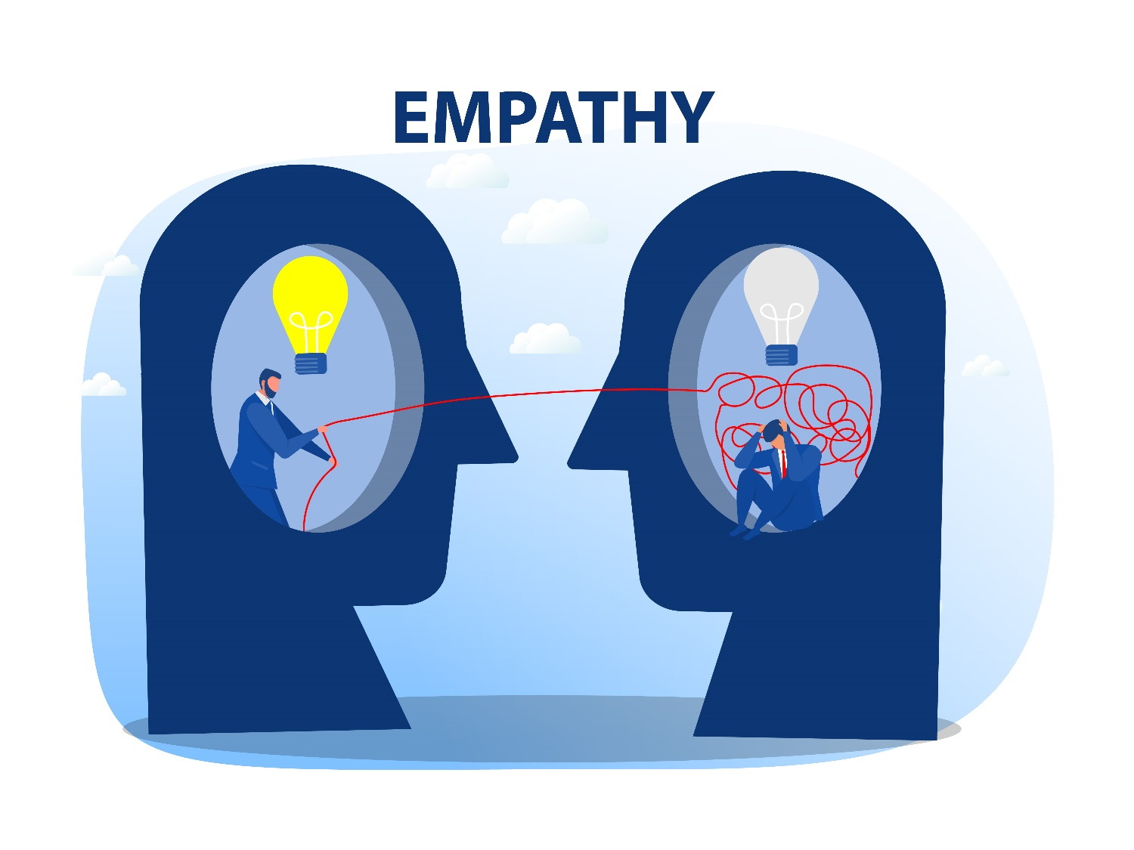
What Is Empathy?
Empathy is the ability to understand and empathize with others' feelings and thoughts, fostering deeper understanding and compassion.
Notes:
It requires time and effort, but it enhances communication skills, and personal and professional connections, and boosts performance in the workplace.

Slide 39
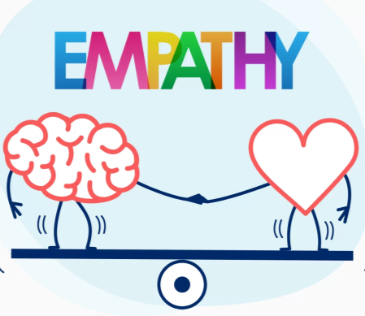
Empathy & Handling Clients
Empathy is dealing with others in their “frame of reference,” not ours.
Identify others’ situations & feelings.
When freelancing, you will notice that customer handling using empathy is required at every step of the way while dealing with your client and their deadlines.
Notes:
Empathy is dealing with others in their “frame of reference,” not ours.
It is the foundation for all the social competencies:
Understanding others: Sensing others’ feelings and perspectives, and taking an active interest in their concerns.
Service orientation: Anticipating, recognizing and meeting customers’ needs.
Leveraging diversity: Cultivating opportunities through diverse people.
Leverage diversity depends on:
Getting on well with people who are different
Appreciating unique ways others operate
Seizing business opportunities
Empathy tactics:
Giving feedback with a dose of encouragement.
Let others take the lead in setting their objectives.
Let others specify their “own” solutions.

Slide 40

How to Practice Empathy
Empathy
Empathy is all about understanding and sharing the feelings of others. It's like stepping into their shoes and seeing the world from their perspective.
Here are some tips to practice Empathy:
Pay attention to nonverbal cues
Understand where they are coming from
Listen with your full attention
Express understanding by asking questions instead of making assumptions
29

Slide 41
Empathy Phrases
“Thanks for the suggestion. I certainly see how this could be useful.”
“I appreciate that feedback.”
“I understand how ‘x’ is preventing you from accomplishing ‘y’”
"I can see how that would be confusing."
“I completely agree with you.”
“That’s a great suggestion.”
"Thanks for reaching out about this!"
“We can work through this together.”
“That sounds extremely challenging.”
“I can see why you’d want that feature.”
“I would feel the same if I were in your shoes.”
“Thank you for your patience.”
"I'll do my best to resolve this issue for you.“
"Let's explore all your options."
"I'm truly sorry for the inconvenience caused."
Notes:
Show the list to the students, read some of the statements and make sure that the students understand them.
You can ask students to read them. They will practice them in the next exercise.

Slide 42

Group Activity: Use Empathy in the below scenarios while dealing with clients
A client who is worried about the deadline to receive your task.
A client who has been taking too long trying to reach you.
Notes:
Notes to trainers: (10 minutes)
Allow students to brainstorm an action to be taken to handle above mentioned situations with empathy.
Ask them to use the empathy phrases in the previous slide.
Ask a new participant in each scenario to share their answers.
Step 2: You can role play some these situations

Slide 43
Components of Emotional Intelligence
Emotional Intelligence
Self
Awareness
Self
Regulation
Empathy
Self
Motivation
30

Slide 44
Components of Emotional Intelligence
Social Skills
31

Slide 45

What are the needed Social Skills?
Social Skills
Social skills are the tools we use to navigate and succeed in our interactions with others.
Here are some examples of the needed skills:
Good Communication
Teamwork & collaboration
Persuasion & Influencing
Conflict Management
32

Slide 46
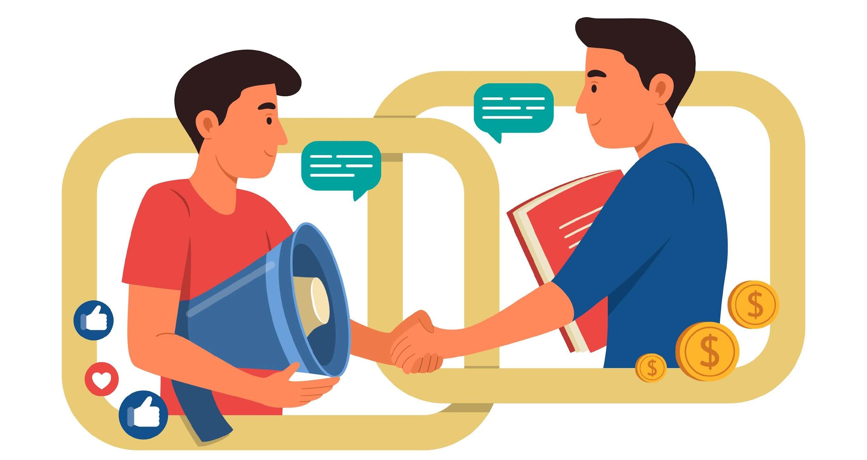
Handling Clients as A Freelancer
Notes:
The trainer asks participants: “How can you handle difficult clients?”.
Then, the trainer asks participants to think about these situations: Handling Clients - Situations.pdf
After having worked with hundreds of clients over the years and hearing my freelance friends’ experiences, I thought I'd draft up a handy list to help you identify the main types of clients you may run into and how to handle them.

Slide 47
Handling Clients as A Freelancer
‘All price’ clients
‘I know it all’ client
‘Indecisive’ client
‘Result-based’ client
Notes:
After having worked with hundreds of clients over the years and hearing my freelance friends’ experiences, I thought I'd draft up a handy list to help you identify the main types of clients you may run into and how to handle them. There are four main types, the:
‘All price’ clients.
‘I know it all’ client.
‘Indecisive’ client.
‘Result-based’ client.

Slide 48
Handling Clients as A Freelancer
‘All price’ clients
For this kind of client, price is everything. Saving money is the top priority, they want the cheapest option possible – even if that means compromising the quality, they mostly hire based on their budget.

Slide 49
Handling Clients as A Freelancer
‘All price’ clients
How to spot them?
My cousin can do this for £400. Why can’t you?
Can you do it for less?
Tell me how much the video costs first.
Your rates are really high, I know Gary does it for £300.

Slide 50
Handling Clients as A Freelancer
‘All price’ clients
How to deal with them?
To deal with these kinds of clients, refer them as fast as possible to someone else. Their priority isn’t quality, it’s the game of spending the least as possible. If the budget is £500 & your minimum level of engagement is £5000, there’s little hope of negotiation so it’s not the gig for you.

Slide 51
Handling Clients as A Freelancer
The ‘I know it all’ client
The one who always knows best.

Slide 52
Handling Clients as A Freelancer
The ‘I know it all’ client
How to spot them?
It's easy, I can do it myself or I did this in the past.
It will just take one hour to create this.
I’ll storyboard the video you just need to shoot exactly that, then it will be easy.
Notes:
They will always want to be heavily involved and advise what’s best, even when they don’t have expertise in that field. Rather than asking questions like, ‘what do you think?’

Slide 53
Handling Clients as A Freelancer
The ‘I know it all’ client
How to deal with them?
Embrace what they say and turn around the conversation.
Client - This isn’t difficult, I know you can do it in just one hour or so. Here’s an idea, I’ll write the script for the video and you just need to follow the script, then you can just knock it out.

Slide 54
Handling Clients as A Freelancer
The ‘I know it all’ client
How to deal with them?
Embrace what they say and turn around the conversation.
Freelancer - I appreciate the suggestion, from my years of experience, there’s a process that involves understanding the script, conceptualizing this into a video/animation, rounds of amends, and a lot more that actually goes into this, to get to the final outcome. [Show your understanding by educating and setting expectations]

Slide 55
Handling Clients as A Freelancer
The ‘I know it all’ client
How to deal with them?
Embrace what they say and turn around the conversation.
Client - But it’s a simple script, right?

Slide 56
Handling Clients as A Freelancer
The ‘I know it all’ client
How to deal with them?
Embrace what they say and turn around the conversation.
Freelancer - [handle any objections head-on] the script itself is fairly simple on paper, although there’s X amount of time involved to understand, produce and refine your film and for this time and expertise, I charge a minimum engagement of £5000.

Slide 57
Handling Clients as A Freelancer
The ‘I know it all’ client
How to deal with them?
Embrace what they say and turn around the conversation.
Client - Can you just work with my script and give me a discount on the price because I’m writing the script for you?

Slide 58
Handling Clients as A Freelancer
The ‘I know it all’ client
How to deal with them?
Embrace what they say and turn around the conversation.
Freelancer - [keep your composure + position x2 outcomes] Your script writing skills are great, you can hire a storyboard artist, camera operator, and animator on a service like Fiverr, who can follow your script and do it for less, although I can’t guarantee the quality of the final film and service will be what I can offer as an all-in-one service, which do you feel is the best solution?

Slide 59
Handling Clients as A Freelancer
The ‘I know it all’ client
How to deal with them?
Embrace what they say and turn around the conversation.
All you have to do is come from the stance of an experienced freelancer and consultant and hold your ground on the value that you offer. If they’re not budging on price or don’t value what you do, politely decline or pay it forward by referring someone else for the gig that it may suit.

Slide 60
Handling Clients as A Freelancer
Indecisive clients
They do market research before they buy anything, a lot of market research. If you educate them in the right way, it could pay off.
How to spot them?
Let me think about it.
Let me check other freelancers.
I’m not sure.
I’m not ready to make the purchase but just asking.
I’m waiting for the money.
Let me check with my partner.
I’ll know when I see it.

Slide 61
Handling Clients as A Freelancer
Indecisive clients
How to deal with them?
Say this - That’s totally fine that you’ll compare quotes and shop around. To let you know, it will be best to contact me last, as I'm likely to be in the top 3 highest bids. I come with 7 years of experience in this field which is the reason I approached you, and may not even have the availability for when you decide that you need me. I don’t want to get into pricing or the proposal just yet, until you’re able to clarify what you want.

Slide 62
Handling Clients as A Freelancer
Indecisive clients
Here’s what you need to let your client know:
Ask your client to call you last, once they’ve shopped around.
Say that you’re likely to be the highest price, which will be in line with the value that you will bring.
Notes:
That they can risk going with a cheaper and less-experienced freelancer, but it’s likely to result in more time through needing more amends, take more of your time to manage them, be done to a lower standard and therefore, less likely to be a high-quality end video.

Slide 63
Handling Clients as A Freelancer
Result-based clients
These are the clients you should aim for. The ones that favour value your time and value the outcome over price. They make decisions on the basis of quality and progress at the forefront of their mind.

Slide 64
Handling Clients as A Freelancer
Result-based clients
How to spot them?
I don’t care where it’s going just get it done fast. (Time)
I’m not going to bother you on each detail because I trust you get it done, just fix it. (Quality)
They have more requests than any other type of client. (Details)

Slide 65
Handling Clients as A Freelancer
Result-based clients
How to deal with them?
Don’t treat them like the rest of the clients – you can use value pricing here. Plus, you don’t need to sell to them because they would’ve done a lot of research and had key decisions made on what they want before reaching out to you.
Notes:
Talk about business problems, ask from the stance of an advisor and consultant, rather than just an ‘operator’ because you’re both in the business of solving problems.

Slide 66

Pair Activity: Role Play
Sample role play with a customer style
Notes:
Notes to trainers: Guess the customer’s style (15 minutes)
You will play the customer role and ask one of the participants to handle your style
Ask the rest of the participants to write down their feedback about the role play and guess the customer style.
Play a new customer style and repeat the role play with a new participant who will try to handle you in the right way.
If time permits, you can role play the 4 styles with 4 different participants.

Slide 67

Creating Customer Delight

Slide 68

Achieving Customer Delight What do customers want?
They want to be understood.
They want to feel welcome.
They want to feel important.
They want to feel comfortable.

Slide 69
Creating Customer Delight
Maintain Thorough Records
Emphasize Open Communication
Build Trust Through Transparency
Manage Clients Closely and Honestly
Set Clear Expectations Early
Give Strong Support and Security

Slide 70
CEOs are hired for their intellect and business expertise – and fired for a lack of Emotional Intelligence
Daniel Goleman
34

Slide 71
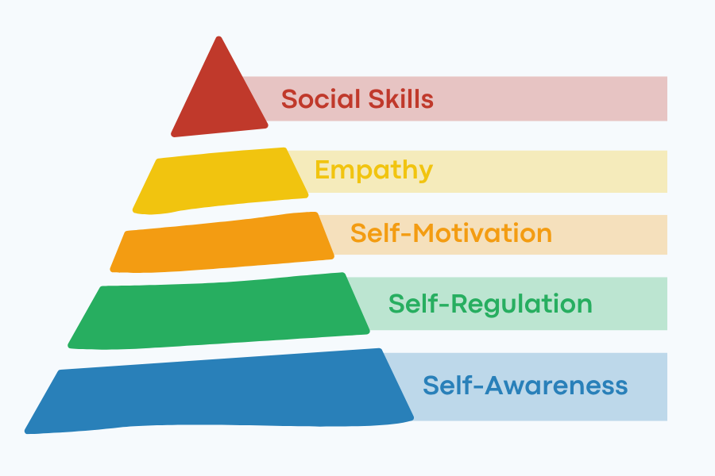
Recap

Slide 72
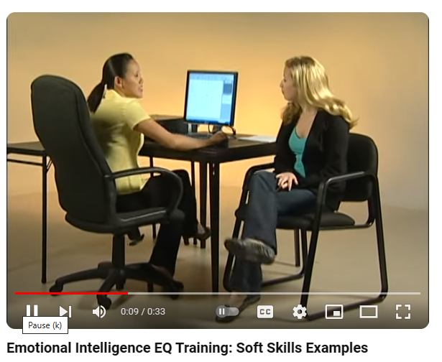
Helpful Resources
Handling complaints using Emotional Intelligence:

Slide 73
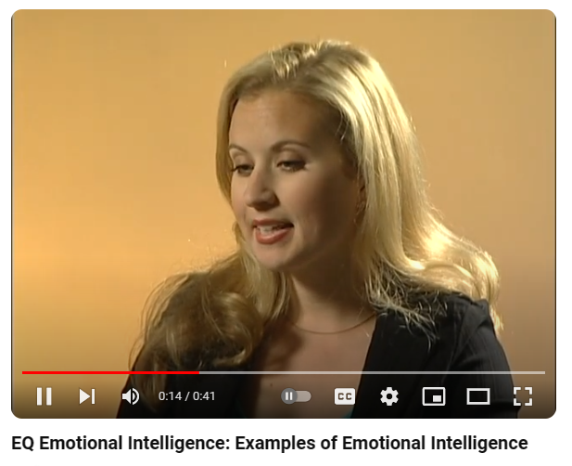
Helpful Resources
Handling complaints using Emotional Intelligence:

Slide 74
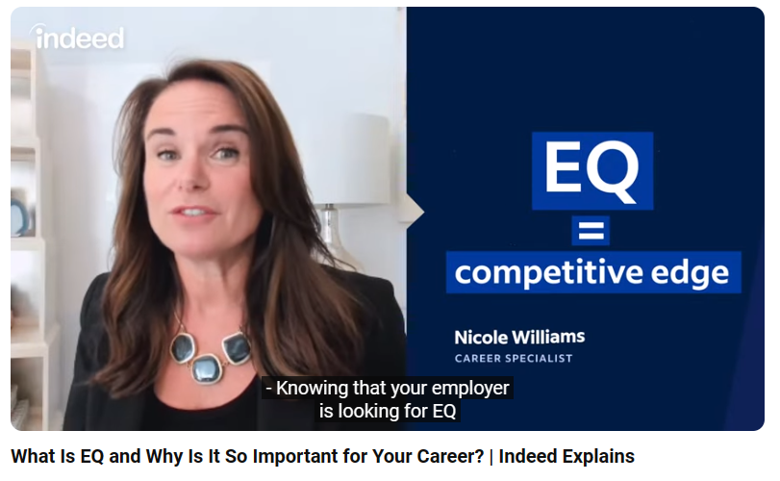
Helpful Resources
Emotional Intelligence to land a job deal:

Slide 75
Helpful Resources Links
Handling complaints using Emotional Intelligence:
https://www.youtube.com/watch?v=2v8ZzvIbq30
https://www.youtube.com/watch?v=BEBidhgoNSs
Emotional Intelligence to land a job deal:
https://www.youtube.com/watch?v=hkLYw5YNP_o

Slide 76


Slide 77
Emotional Intelligence Handout
Notes:
Plz send to the students on chat

Slide 78
We welcome your feedback
https://docs.google.com/forms/d/e/1FAIpQLSc2RHrirQC4v6rx_kUZm7p6F-8HvjR4XFDJgI9KIWvVzrXcSg/viewform?usp=sharing
35
Notes:
https://docs.google.com/forms/d/e/1FAIpQLSc2RHrirQC4v6rx_kUZm7p6F-8HvjR4XFDJgI9KIWvVzrXcSg/viewform?usp=sharing

Slide 79
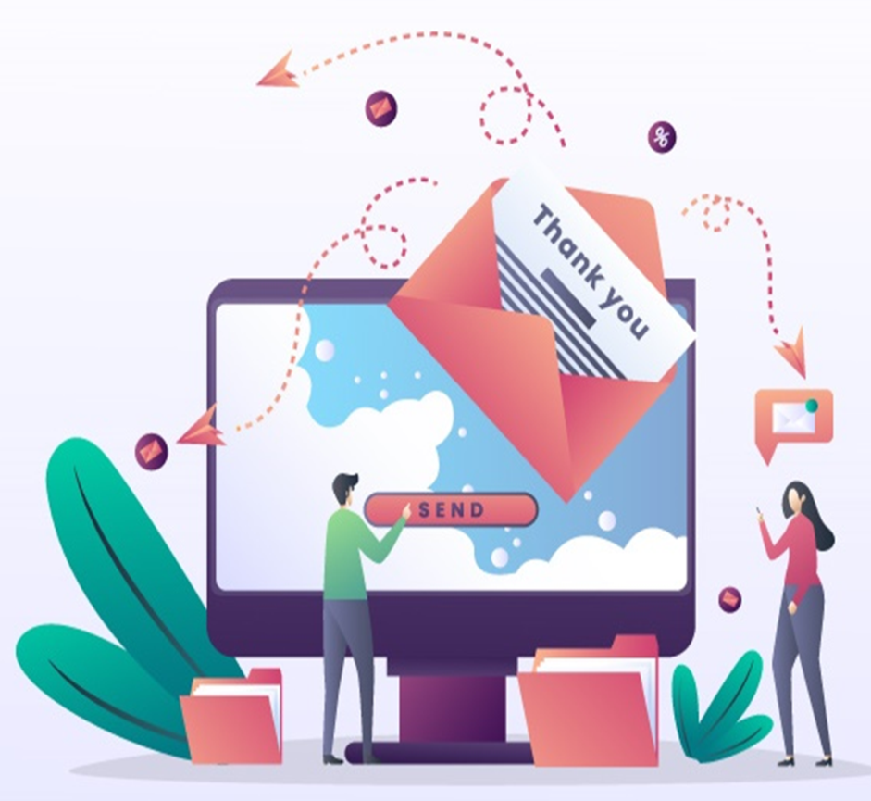
Thank You for your participation and attention

